Slide 1
Welcome to
Cultivation management system

Slide 2
A project on
Cultivation management System
Presented by
M.Kirankumarreddy
J.Vinodhkumar
D.Kirankumar

Slide 3
Abstract
Indian Cultivation has an extensive background which goes back to at least 10 thousand years. Currently the country holds the second position in agricultural production in the world.
India is the second biggest producer of wheat, rice, cotton, sugarcane, silk, groundnuts, and dozens more.
The major fruits produced by India are mangoes, papayas, sapota, and bananas.
India also has the biggest number of livestock in the world, holding 281 million. In 2008, the country housed the second largest number of cattle in the world with 175 million.

Slide 4
Contents
Introduction
System Analysis
Modules
System Requirement
System Design
System implementation
Screenshots
Conclusion

Slide 5
1. Introduction
Shopping has evolved with the growth of technology. In recent years online Cultivation shopping has become popular and one who has a computer with Internet and a bank account can shop from their home.
Shopping online offers lots of benefits that one cannot find shopping in a store or by mail.
The Internet is always open — seven days a week, 24 hours a day. With a click of a mouse, one can buy an airline ticket, book a hotel, send flowers to a friend, or purchase your favorite fashions etc, so online Cultivation shopping will helps Farmer.

Slide 6
2. System Analysis
Existing System
In Past Days Buying & Selling of Pesticides is Manually happening, so with this Manual System Farmers face lot of Problems.
In Earlier Days, if any Farmer wants to buy Pesticides Means he need to travel several kilometers, it is very risky & time taken process & also have transport Problems.

Slide 7
Disadvantages
If any Farmer wants to buy Pesticides Means he need to travel several kilometers.
It is very risky & time taken process
Transport Problems because Customers from a certain area go for shopping.
Limited customer reach.

Slide 8
Proposed system
Online Cultivation Shopping allows visitors to shop on-line to collect items.
Shoppers may view the contents of their shopping cart at any time.
Customers can shop from their home.
Customers can view a large number of products available in a store.

Slide 9
Advantages
No need to travel several kilometers for buying Pesticides because Customers can shop from their home.
Customers can view a large number of products available in a store.
It doesn’t takes lot of time to buy.
We don’t have any transport Problem in online shopping.

Slide 10
3.Modules
Registration
Login
Customer
Dealer
Request

Slide 11
Module Description
Registration
In this Module Customer needs to enter all the Details for Authentication then only customer have a chance to process the site.
Login
After Registration customer enter his/her username & Password here for entering into the site.
Customer
After Login Customer will Enters into Site to See different available Products & sends Request to Retailer for the Available Products.
Dealer
Retailer can view all the Customer Requests & he checks the status then he Process the Request of Customer.
Request
In this Module Customer will Requests for the available Products which are posted by Retailer.

Slide 12
4. System Requirements
S/W System Configuration
Operating System : Windows
Technology : Java/j2ee (JDBC, Servlets, JSP)
Web Technologies : Html, JavaScript, CSS
Web Server : Tomcat
Database : Oracle Xe
Software’s : J2SDK1.7, Tomcat 7, Mysql 5.1

Slide 13
H/W System Configuration
Hardware : Pentium based systems with a
minimum of p4
RAM : 256MB (minimum)
Cache : 512MB
Hard disk : 10GB

Slide 14
5. System Design
Class Diagram

Slide 15
Usecase Diagram For Customer

Slide 16
Usecase Diagram For Dealer

Slide 17
Sequence Diagram for Custmor

Slide 18
Sequence Diagram for Dealer

Slide 19
Collaboration Diagram For Customer

Slide 20
Collaboration Diagram For Dealer

Slide 21
Component Diagram For Customer

Slide 22
Component Diagram For Dealer

Slide 23
6. System Implementation
Java Technology
Java technology is both a programming language and a platform.
The Java programming language is a high-level language that can be characterized by all of the following buzzwords:
Simple
Architecture neutral
Object oriented
Portable
Distributed
High performance
Interpreted
Multithreaded
Robust
Dynamic
Secure

Slide 24
Tomcat 6.0 web server
Tomcat is an open source web server developed by Apache Group.
The Java Servlet and Java Server Pages specifications are developed by Sun under the Java Community Process.
Web Servers like Apache Tomcat support only web components while an application server supports web components as well as business components (BEAs Weblogic, is one of the popular application server).
To develop a web application with jsp/ servlet install any web server like JRun, Tomcat etc to run your application.

Slide 25
MySQL Database
MySQL is fast and very easy-to-use RDBMS used being for many small and big businesses.
MySQL is developed, marketed, and supported by MySQL AB, which is a Swedish company.
It is released under an open-source license.
It use a standard form of the well-known SQL data language.
It works on many operating systems and with many languages including PHP, PERL, C, C++, JAVA etc.
MySQL works very quickly and works well even with large data sets.

Slide 26
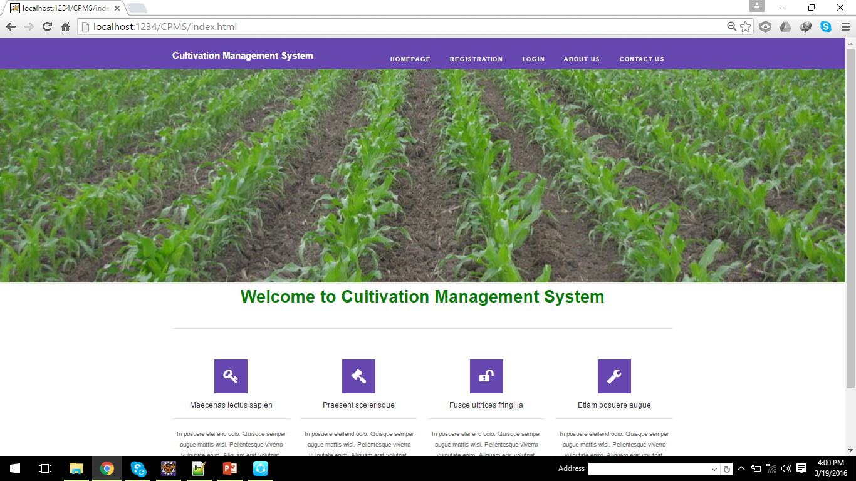
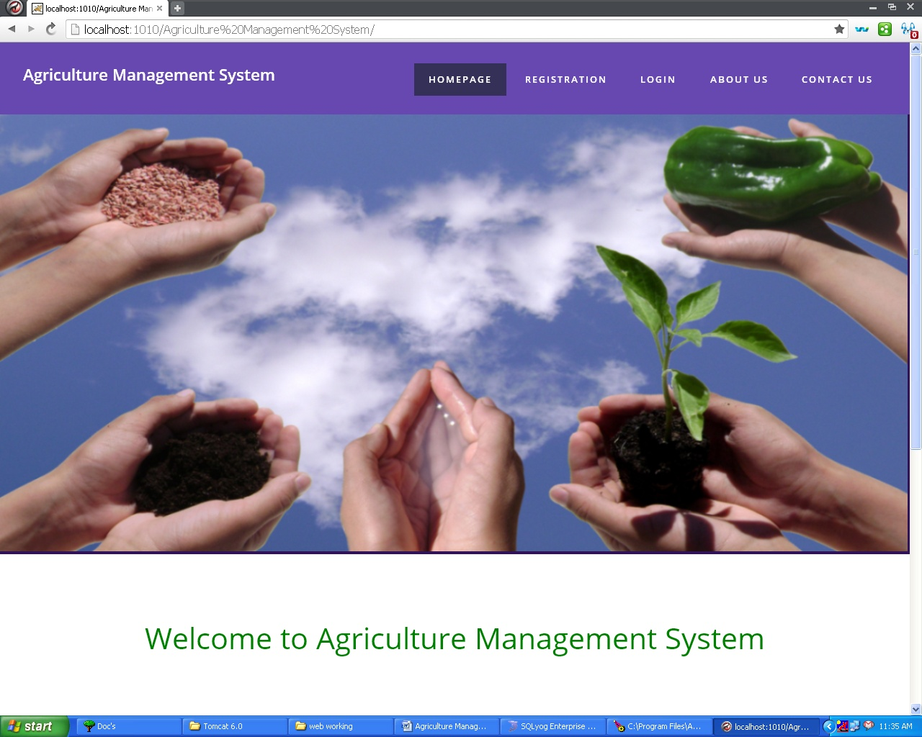
7. Screen shots Home page

Slide 27
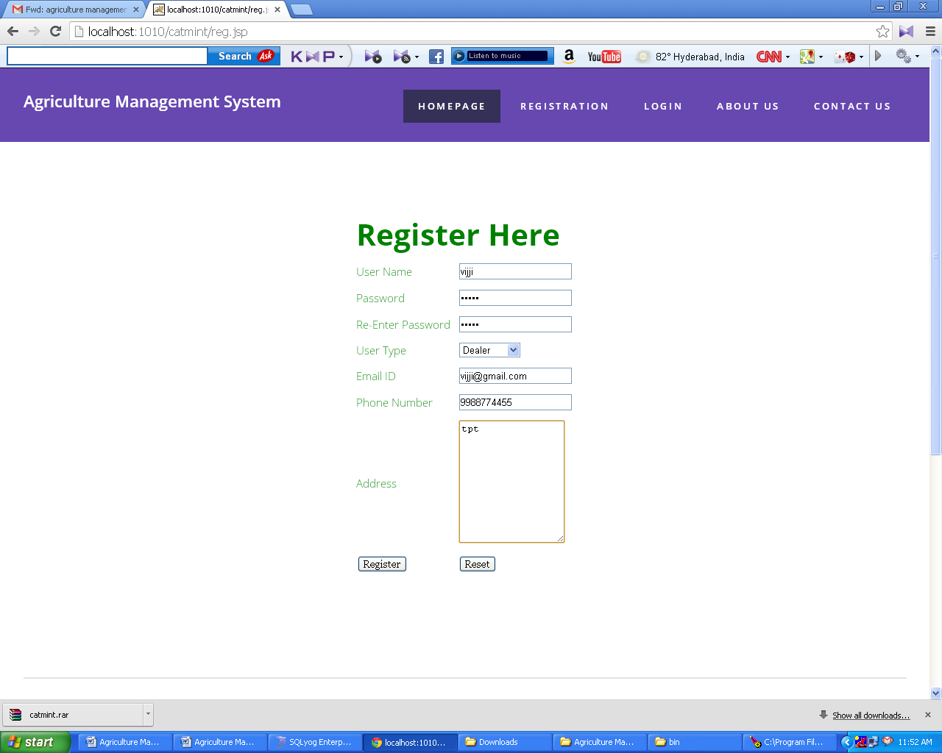
Registration for Dealer

Slide 28
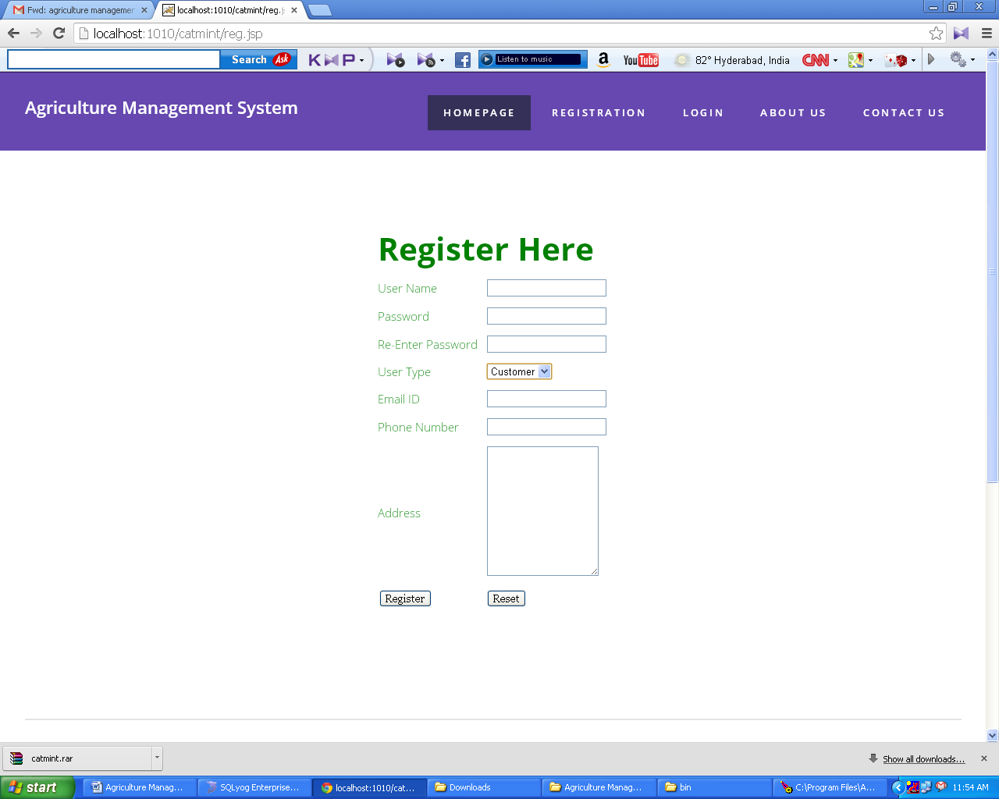
Registration for Customer

Slide 29
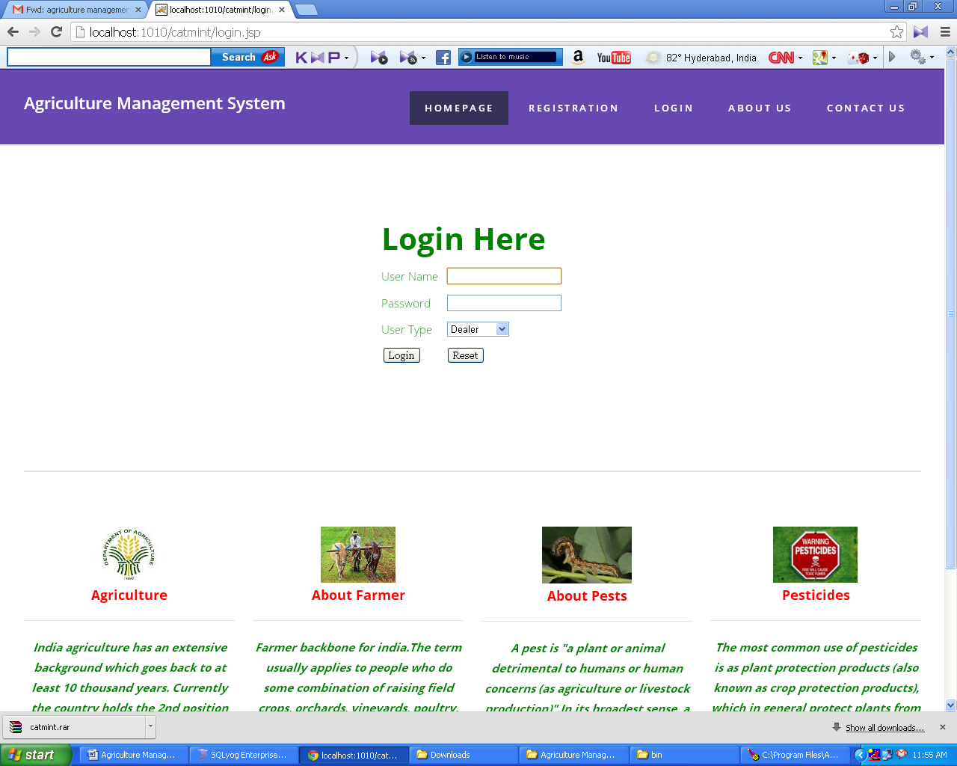
Login for Dealer

Slide 30

Login for Customer

Slide 31
Any ....?

Slide 32
THANK U

